Slide 1
AWS Intro
AWS Certified Solutions Architect - Associate (SAA-C01)

Slide 2
Exam - Details
https://aws.amazon.com/certification/certified-solutions-architect-associate/

Slide 3
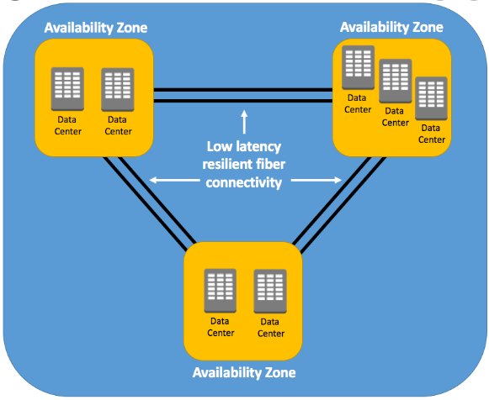
. What are AWS Regions?
AWS Regions are separate geographic areas that AWS uses to house its infrastructure. These are distributed around the world so that customers can choose a region closest to them in order to host their cloud infrastructure there. The closer your region is to you, the better, so that you can reduce network latency as much as possible for your end-users. You want to be near the data centres for fast service.
. What is AZ
An AWS Availability Zone (AZ) is the logical building block that makes up an AWS Region
There are few services which doesn’t need Regions like IAM, S3 etc..,
18 AWS Regions as per 2020
Az and Regions

Slide 4

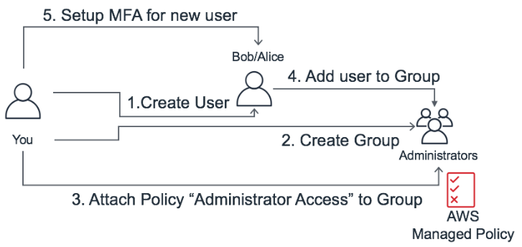
IAM - Identity and access management
Users
Groups
Roles
Policy – Policy’s are attached to U,G,R - There are basically permissions to AWS Resources.
We can make users to login to aws by directly user their company credentials by IDP using SAML (Security Assertion Markup Language) which enables SSO (single signon)
What is Saml - https://www.youtube.com/watch?v=0fmNoqz6Urw
Identity Provider integration - https://www.youtube.com/watch?v=CYTN8AAQtrg
Activate MFA - https://www.youtube.com/watch?v=A3AObXBJ4Lw

Slide 5
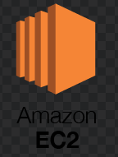
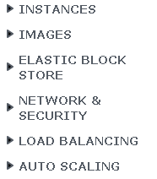
EC2 - Elastic Compute Cloud
No | Machine Type | Instance Type | Port | Key | Mode of connection | Tool
1 | Linux | Linux | 22 | Pem | SSH | terminal
2 | Windows | Linux | 22 | Ppk | SSH | Putty
3 | Windows | Windows | 3389 | Pem | RDP | mstsc
4 | Mac | L/W | 22/3389 | Pem/ppk | Ssh/rdp | terminal
Launch instance and connect to it.
Connecting methods

Slide 6

AMI – amazon machine image
This service is used for making an custom image
Enables us to make faster boot process with our custom requirements
By default your AMI’s are stored in s3 which are private and locked to region
We can not see them in the s3 console though
We can make Our custom AMI as a Public and rent others with custom applications running in it
By placing them in the market place
Do not trust every public AMI – look at the secc urity concers and malwares comes with it.

Slide 7

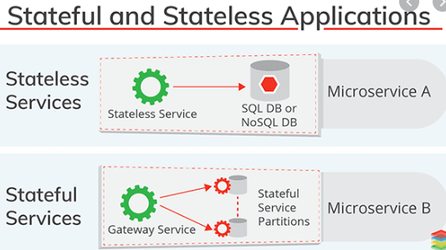
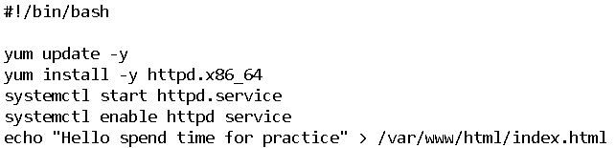
Security Group
This Acts as a firewall to the resources.
All Inbound rules are blocked by default
All Outbound rules are allowed by default
We can attach single SG to multiple resources
We can add multiple SG to single resource, max 5
Security groups are stateful in nature.
Security rules are always permissive.
IP Types
Public Ip
Ip Changes every time the instance is restarted (Dynamic)
Elastic Ip
To make Public Ip as Static then we use this
Private IP
Ip Remains Constant till instance is terminated (Static)
User Data
This is used for scripts to run during bootstrap while launching

Slide 8
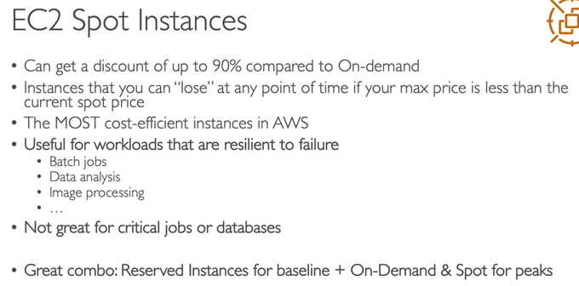
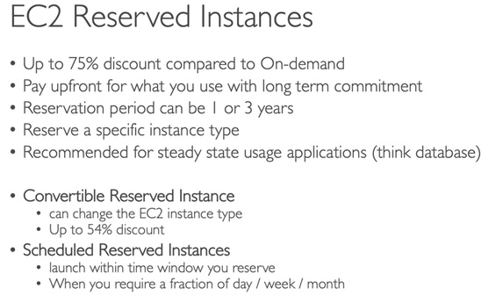
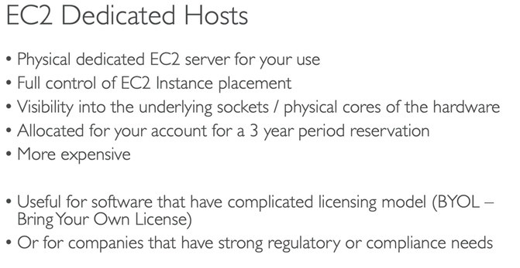
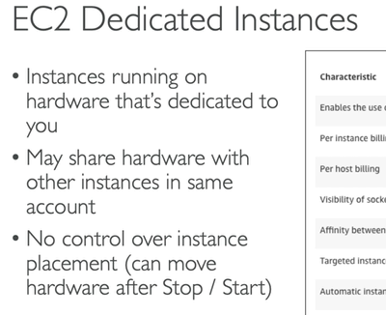
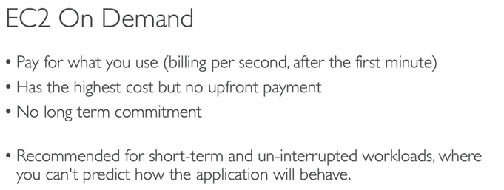
Instance types -1
Document Link

Slide 9
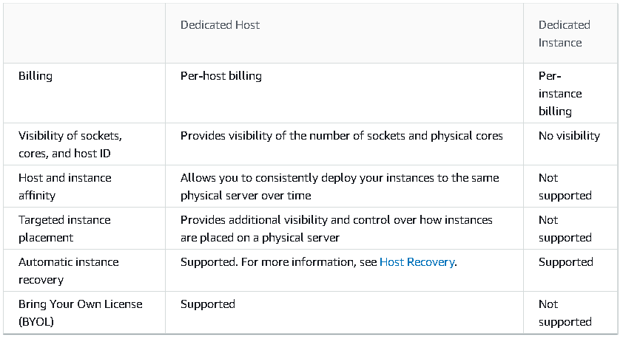
Diff btw Dedicated Host/instance

Slide 10
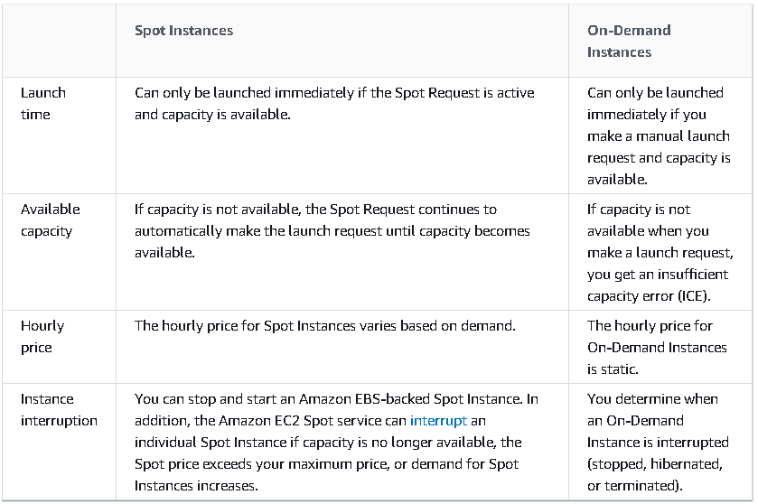
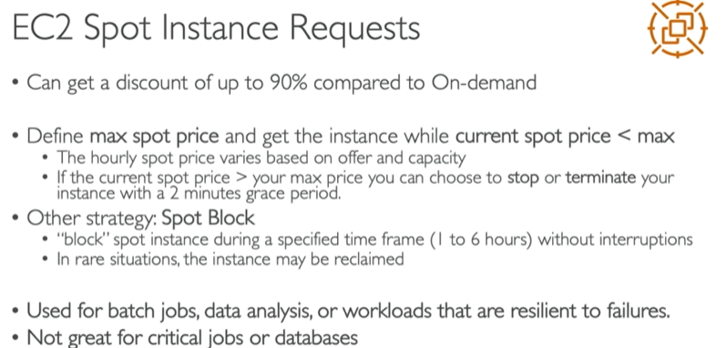
Diff btw Sopt and On-Demand Instances
Spot Fleet – Set of spot instances + Optional (On-demand instances) = meet the requirement/targer

Slide 11
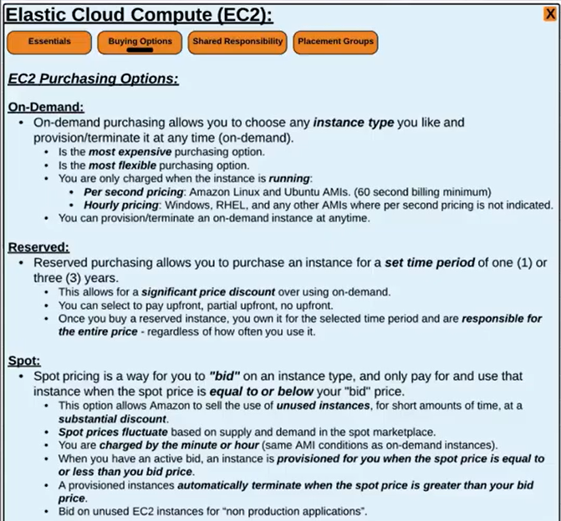
Instance types -2
Document Link

Slide 12
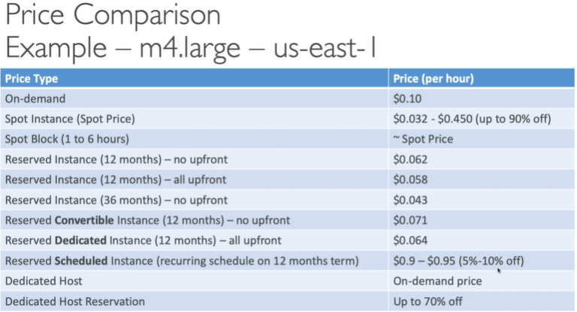
Pricing

Slide 13
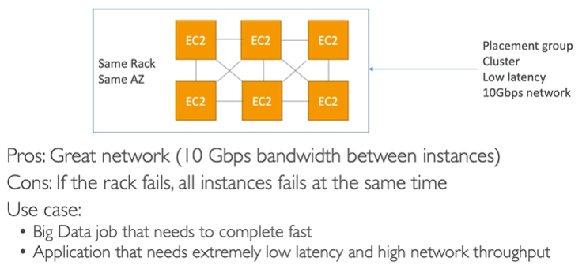
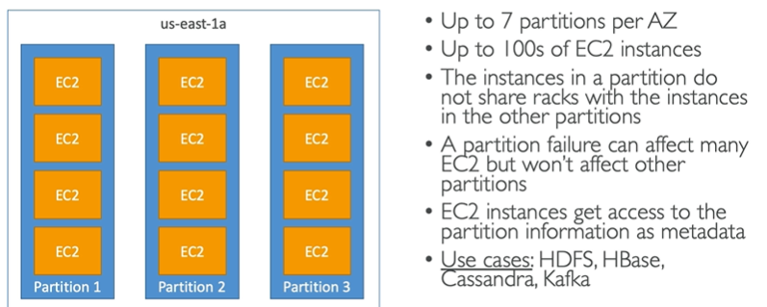
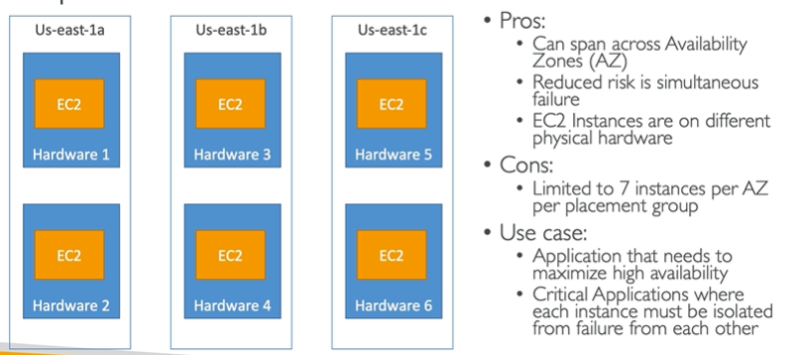
Placement Groups
Cluster – packs instances close together inside an Availability Zone. This strategy enables workloads to achieve the low-latency network performance necessary for tightly-coupled node-to-node communication that is typical of HPC applications.
Partition – spreads your instances across logical partitions such that groups of instances in one partition do not share the underlying hardware with groups of instances in different partitions. This strategy is typically used by large distributed and replicated workloads, such as Hadoop, Cassandra, and Kafka.
Spread – strictly places a small group of instances across distinct underlying hardware to reduce correlated failures.

Slide 14
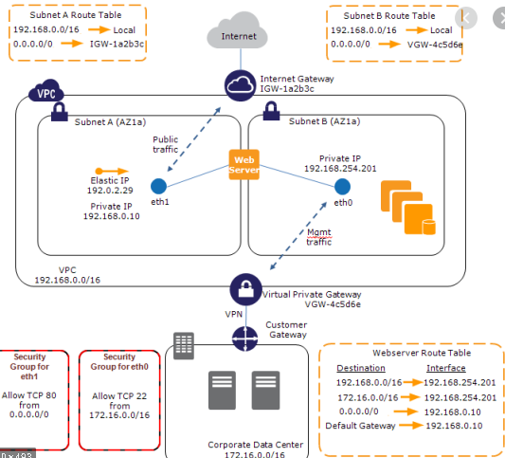
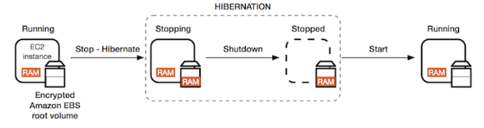
ENI And Hibernation

